Slide 1
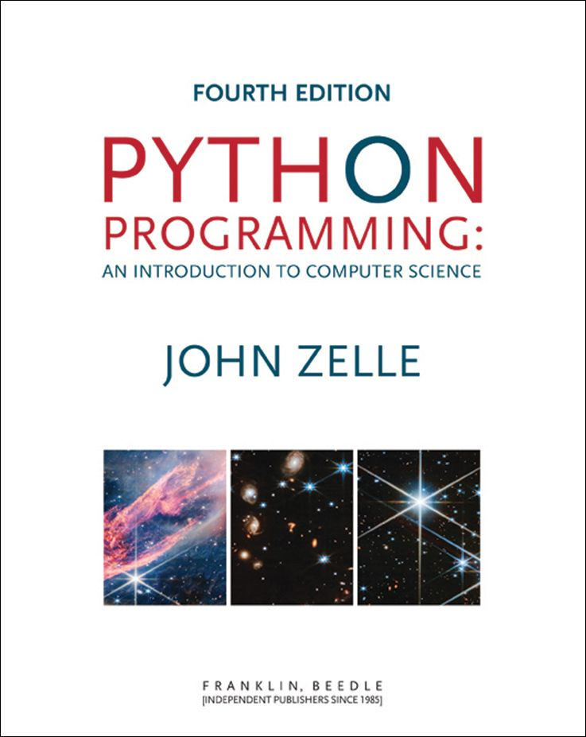
Python Programming: An Introduction to Computer Science
Chapter 2
Writing Simple Programs
Python Programming, 4/e
1

Slide 2
Objectives
To know the steps in an orderly software development process.
To understand programs following the input, process, output (IPO) pattern and be able to modify them in simple ways.
To understand the rules for forming valid Python identifiers and expressions.
Python Programming, 4/e
2

Slide 3
Objectives
To be able to understand and write Python statements to output information to the screen, assign values to variables, get numeric information entered from the keyboard, and perform a counted loop
Python Programming, 4/e
3

Slide 4
The Software Development Process
The process of creating a program is often broken down into stages according to the information that is produced in each phase.
Python Programming, 4/e
4

Slide 5
The Software Development Process
Analyze the Problem Figure out exactly the problem to be solved. Try to understand it as much as possible.
Python Programming, 4/e
5

Slide 6
The Software Development Process
Determine Specifications Describe exactly what your program will do.
Don’t worry about how the program will work, but what it will do.
Includes describing the inputs, outputs, and how they relate to one another.
Python Programming, 4/e
6

Slide 7
The Software Development Process
Create a Design
Formulate the overall structure of the program.
This is where the how of the program gets worked out.
Develop your own algorithm that meets the specifications.
Python Programming, 4/e
7

Slide 8
The Software Development Process
Implement the Design
Translate the design into a computer language.
In this course we will use Python.
Python Programming, 4/e
8

Slide 9
The Software Development Process
Test/Debug the Program
Try out your program to see if it worked.
If there are any errors (bugs), they need to be located and fixed. This process is called debugging.
Your goal is to find errors, so try everything that might “break” your program!
Python Programming, 4/e
9

Slide 10
The Software Development Process
Maintain the Program
Continue developing the program in response to the needs of your users.
In the real world, most programs are never completely finished – they evolve over time.
Python Programming, 4/e
10

Slide 11
Example Program: Temperature Converter
Analysis – the temperature is given in Celsius, user wants it expressed in degrees Fahrenheit.
Specification
Input – temperature in Celsius
Output – temperature in Fahrenheit
Output = 9/5(input) + 32
Python Programming, 4/e
11

Slide 12
Example Program: Temperature Converter
Design
Input, Process, Output (IPO)
Prompt the user for input (Celsius temperature)
Process it to convert it to Fahrenheit using F = 9/5(C) + 32
Output the result by displaying it on the screen
Python Programming, 4/e
12

Slide 13
Example Program: Temperature Converter
Before we start coding, let’s write a rough draft of the program in pseudocode
Pseudocode is precise English that describes what a program does, step by step.
Using pseudocode, we can concentrate on the algorithm rather than the programming language.
Python Programming, 4/e
13

Slide 14
Example Program: Temperature Converter
Pseudocode:
Input the temperature in degrees Celsius (call it celsius)
Calculate fahrenheit as (9/5)*celsius+32
Output fahrenheit
Now we need to convert this to Python!
Python Programming, 4/e
14

Slide 15
Example Program: Temperature Converter
#convert.py
# A program to convert Celsius temps to Fahrenheit
# by: Susan Computewell
def main():
celsius = float(input("What is the Celsius temperature? "))
fahrenheit = (9/5) * celsius + 32
print("The temperature is ",fahrenheit," degrees Fahrenheit.")
main()
Python Programming, 4/e
15
Notes:
Python Programming, 3/e
15

Slide 16
Example Program: Temperature Converter
Once we write a program, we should test it!
>>>
What is the Celsius temperature? 0
The temperature is 32.0 degrees Fahrenheit.
>>> main()
What is the Celsius temperature? 100
The temperature is 212.0 degrees Fahrenheit.
>>> main()
What is the Celsius temperature? -40
The temperature is -40.0 degrees Fahrenheit.
>>>
Python Programming, 4/e
16

Slide 17
Elements of Programs
Names
Names are given to variables (celsius, fahrenheit), modules (main, convert), etc.
These names are called identifiers
Every identifier must begin with a letter or underscore (“_”), followed by any sequence of letters, digits, or underscores.
Identifiers are case sensitive.
Python Programming, 4/e
17

Slide 18
Elements of Programs
These are all different, valid names
X
Celsius
Spam
spam
spAm
Spam_and_Eggs
Spam_And_Eggs
Python Programming, 4/e
18

Slide 19
Elements of Programs
Some identifiers are part of Python itself. These identifiers are known as reserved words (or keywords). This means they are not available for you to use as a name for a variable, etc. in your program.
and, del, for, is, raise, assert, elif, in, print, etc.
For a complete list, see Table 2.1 (p. 36)
Python Programming, 4/e
19

Slide 20
Elements of Programs
Expressions
The fragments of code that produce or calculate new data values are called expressions.
Literals are used to represent a specific value, e.g. 3.9, 1, 1.0
Simple identifiers can also be expressions.
Also included are strings (textual data) and string literals (like "Hello").
Python Programming, 4/e
20

Slide 21
Elements of Programs
>>> x = 5
>>> x
5
>>> print(x)
5
>>> print(spam)
Traceback (most recent call last):
File "<pyshell#15>", line 1, in -toplevel-
print spam
NameError: name 'spam' is not defined
>>>
NameError is the error when you try to use a variable without a value assigned to it.
Python Programming, 4/e
21

Slide 22
Elements of Programs
Simpler expressions can be combined using operators.
+, -, *, /, **
Spaces are irrelevant within an expression.
The normal mathematical precedence applies.
((x1 – x2) / 2*n) + (spam / k**3)
Python Programming, 4/e
22

Slide 23
Elements of Programs
Output Statements
print() print(<expr>, <expr>, …, <expr>)
A print statement can print any number of expressions.
Successive print statements will display on separate lines.
A bare print will print a blank line.
print(<expr>, end = " ")
Python Programming, 4/e
23

Slide 24
Elements of Programs
print(3+4)
print(3, 4, 3+4)
print()
print(3, 4, end=" "),
print(3 + 4)
print("The answer is", 3+4)
7
3 4 7
3 4 7
The answer is 7
Python Programming, 4/e
24

Slide 25
Assignment Statements
Simple Assignment
<variable> = <expr> variable is an identifier, expr is an expression
The expression on the RHS is evaluated to produce a value which is then associated with the variable named on the LHS.
Python Programming, 4/e
25

Slide 26
Assignment Statements
x = 3.9 * x * (1-x)
fahrenheit = 9/5 * celsius + 32
x = 5
Python Programming, 4/e
26

Slide 27
Assignment Statements
Variables can be reassigned as many times as you want!
>>> myVar = 0
>>> myVar
0
>>> myVar = 7
>>> myVar
7
>>> myVar = myVar + 1
>>> myVar
8
>>>
Python Programming, 4/e
27

Slide 28
Assignment Statements
Variables are like a box we can put values in.
When a variable changes, the old value is erased and a new one is written in.
Python Programming, 4/e
28

Slide 29
Assignment Statements
Technically, this model of assignment is simplistic for Python.
Python doesn't overwrite these memory locations (boxes).
Assigning a variable is more like putting a “sticky note” on a value and saying, “this is x”.
Python Programming, 4/e
29

Slide 30
Assigning Input
The purpose of an input statement is to get input from the user and store it into a variable.
<variable> =input(<prompt>)
Here, prompt is a string expression used to prompt the user for input.
Python Programming, 4/e
30

Slide 31
Assigning Input
First the prompt is printed
The input part waits for the user to enter a value and press <enter>
The expression that was entered is a string of characters.
The value is assigned to the variable.
For string input: <var> = input(<prompt>)
Python Programming, 4/e
31

Slide 32
Assigning Input
When you want a number from the user, include either int or float around the input to convert the digits into either a whole value (integer) or fractional value (float).
Python Programming, 4/e
32

Slide 33
Simultaneous Assignment
Several values can be calculated at the same time
<var1>, <var2>, … = <expr1>, <expr2>, …
Evaluate the expressions in the RHS and assign them to the variables on the LHS
sum, diff = x+y, x-y
Python Programming, 4/e
33

Slide 34
Simultaneous Assignment
How could you use this to swap the values for x and y?
Why doesn’t this work? x = y y = x
We could use a temporary variable…
Python Programming, 4/e
34

Slide 35
Simultaneous Assignment
We can swap the values of two variables quite easily in Python!
x, y = y, x
>>> x = 3
>>> y = 4
>>> print(x, y)
3 4
>>> x, y = y, x
>>> print(x, y)
4 3
Python Programming, 4/e
35

Slide 36
Definite Loops
A definite loop executes a definite number of times, i.e., at the time Python starts the loop it knows exactly how many iterations to do.
for <var> in <sequence>: <body>
The beginning and end of the body are indicated by indentation.
This is the counted loop pattern.
Python Programming, 4/e
36

Slide 37
Definite Loops
for <var> in <sequence>: <body>
The variable after the for is called the loop index. It takes on each successive value in sequence.
Often, the sequence portion consists of a list of values.
A list is a sequence of expressions in square brackets.
Python Programming, 4/e
37

Slide 38
Definite Loops
>>> for i in [0,1,2,3]:
print (i)
0
1
2
3
>>> for odd in [1, 3, 5, 7]:
print(odd*odd)
1
9
25
49
>>>
Python Programming, 4/e
38

Slide 39
Definite Loops
In chaos.py, what did range(10) do? >>> list(range(10)) [0, 1, 2, 3, 4, 5, 6, 7, 8, 9]
range is a built-in Python function that generates a sequence of numbers, starting with 0.
list is a built-in Python function that turns the sequence into an explicit list
The body of the loop executes 10 times.
Python Programming, 4/e
39

Slide 40
Definite Loops
The name of the index variable doesn’t matter much.
Programmers often use i or j.
If you don’t reference the index variable inside your loop, you can leave it anonymous.
for _ in range(3):
print("Howdy!")
Python Programming, 4/e
40

Slide 41
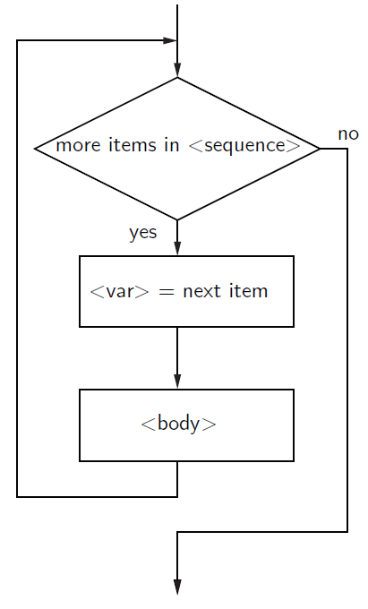
Definite Loops
for loops alter the flow of control, so they are referred to as control structures.
Python Programming, 4/e
41

Slide 42
Example Program: Future Value
Analysis
Money deposited in a bank account earns interest.
How much will the account be worth 10 years from now?
Inputs: principal, interest rate
Output: value of the investment in 10 years
Python Programming, 4/e
42

Slide 43
Example Program: Future Value
Specification
User enters the initial amount to invest, the principal
User enters an annual percentage rate, the interest
The specifications can be represented like this …
Python Programming, 4/e
43

Slide 44
Example Program: Future Value
Program Future Value
Inputs principal The amount of money being invested, in dollars apr The annual percentage rate expressed as a decimal number.
Output The value of the investment 10 years in the future
Relatonship Value after one year is given by principal * (1 + apr). This needs to be done 10 times.
Python Programming, 4/e
44

Slide 45
Example Program: Future Value
Design
Print an introduction
Input the amount of the principal (principal)
Input the annual percentage rate (apr)
Repeat 10 times:
principal = principal * (1 + apr)
Output the value of principal
Python Programming, 4/e
45

Slide 46
Example Program: Future Value
Implementation
Each line translates to one line of Python (in this case)
Print an introduction print ("This program calculates the future") print ("value of a 10-year investment.")
Input the amount of the principal principal = eval(input("Enter the initial principal: "))
Python Programming, 4/e
46

Slide 47
Example Program: Future Value
Input the annual percentage rate apr = eval(input("Enter the annual interest rate: "))
Repeat 10 times: for i in range(10):
Calculate principal = principal * (1 + apr) principal = principal * (1 + apr)
Output the value of the principal at the end of 10 years print ("The value in 10 years is:", principal)
Python Programming, 4/e
47

Slide 48
Example Program: Future Value
# futval.py
# A program to compute the value of an investment
# carried 10 years into the future
def main():
print("This program calculates the future value of a 10-year investment.")
principal = float(input("Enter the initial principal: "))
apr = float(input("Enter the annual interest rate: "))
for _ in range(10):
principal = principal * (1 + apr)
print ("The value in 10 years is:", principal)
main()
Python Programming, 4/e
48

Slide 49
Example Program: Future Value
>>> main()
This program calculates the future value of a 10-year investment.
Enter the initial principal: 100
Enter the annual interest rate: .03
The value in 10 years is: 134.391637934
>>> main()
This program calculates the future value of a 10-year investment.
Enter the initial principal: 100
Enter the annual interest rate: .10
The value in 10 years is: 259.37424601
Python Programming, 4/e
49

